Slide 1
Version
June 2011
Notes:
© 2006 Capgemini - All rights reserved
0

Slide 2
Objective
At the end of this session, participants will:
Know features of Version
Be able to create simple Version
Be able to add features to Version
Adding Header
Displaying Multiple fields per line
Adding Sub-heading

Slide 3
Introduction
Core T24 applications contains many fields, where all the fields are not required for every banker
Customization of the T24 application as per user usage is required
Version can contain other fields (non-mandatory), if required

Slide 4
What is Version?
An alternative view of T24 core application
Customized for end user
Different views for same application for different end users

Slide 5
Why Version?
User restricted to using/changing only certain fields
Fields require grouping to be more presentable

Slide 6
Use of Version
Can be launched from menus for easy navigation
Can launch into other applications

Slide 7
Features of Version
Additional features can be added to fields
Heading can be added
Comments in the form of sub-headings can be added between fields
Routines can be added for pre-processing
Number of authorizers for application records can be set

Slide 8
Creation Procedure
Sign on to T24
Enter ‘VERSION I’ in command line
ID for version is <ApplicationName>,<VersionName>
Input the required fields that should appear on your version
Commit and authorize the newly created version

Slide 9
Creation Procedure
NOTE:
While creating a version for an application
Mandatory fields should be entered
Required fields linked with Mandatory fields should also be entered
(To avoid error while committing the record)

Slide 10
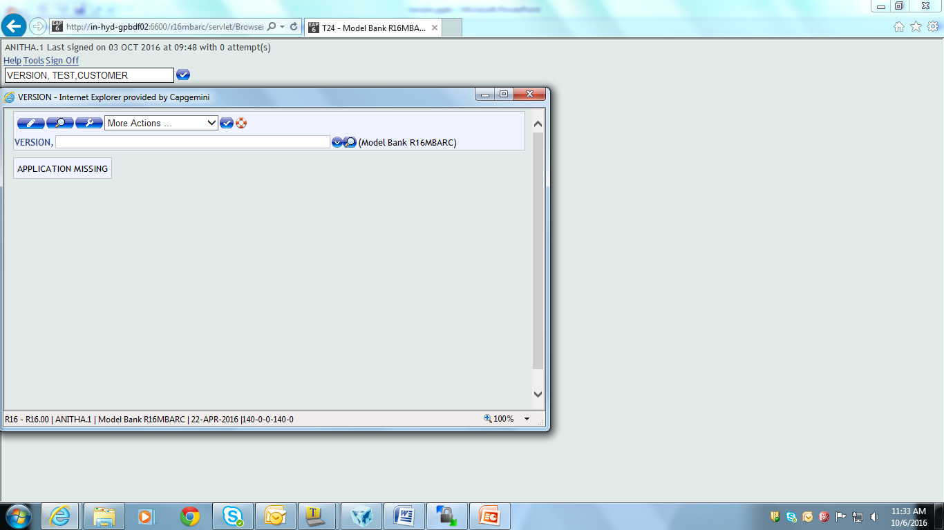
Creation Procedure
This is an invalid ID for creating a Version

Slide 11
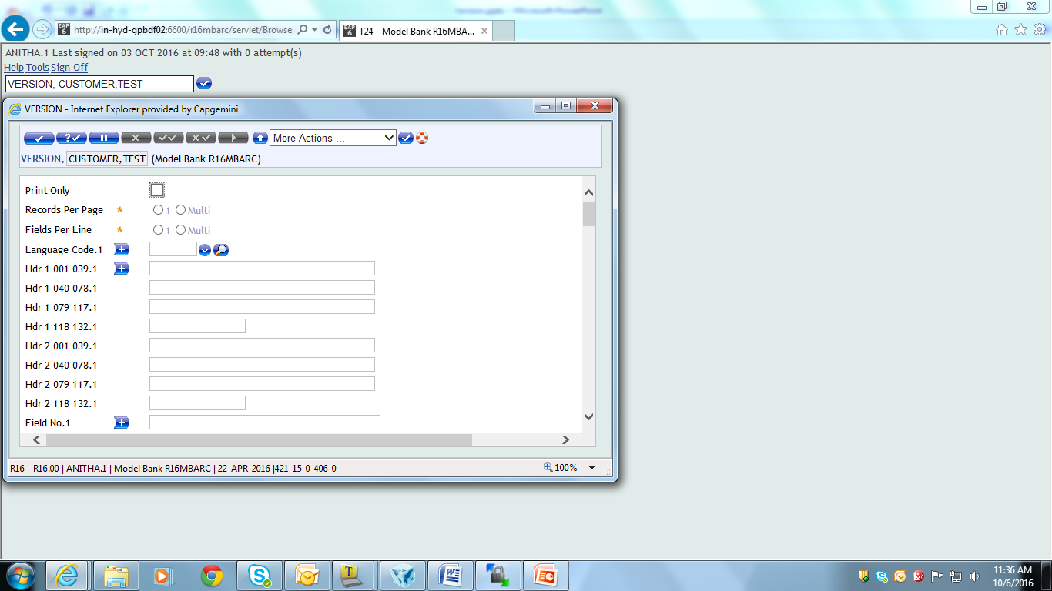
Creation Procedure
This is a valid ID for creating a Version

Slide 12
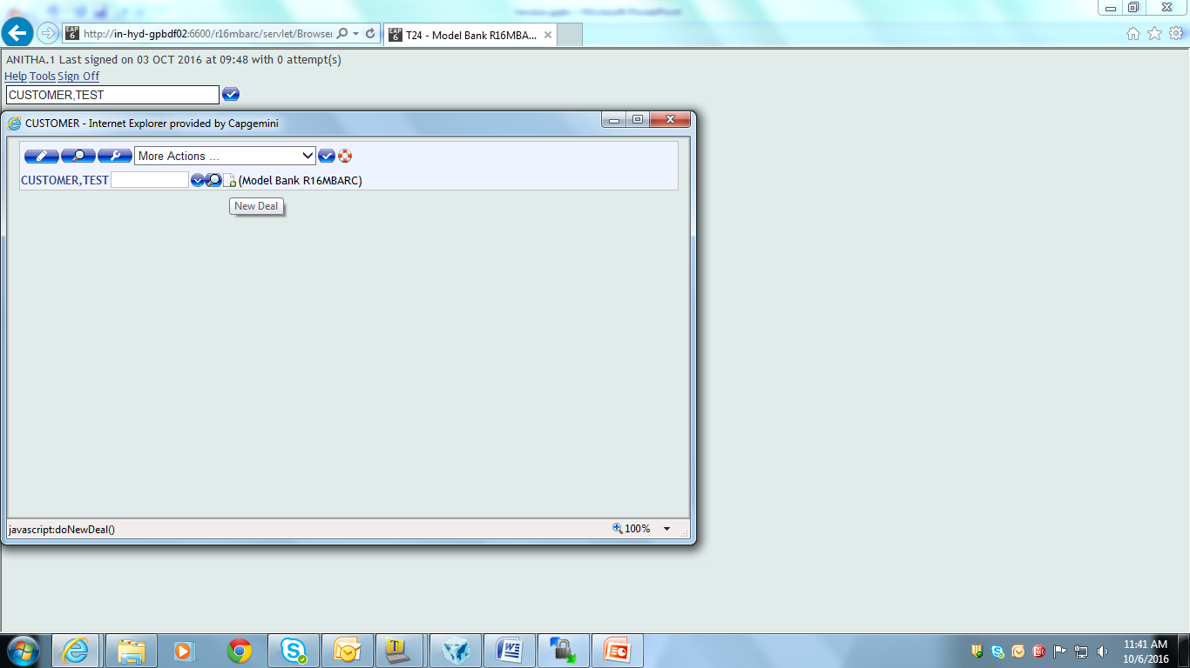
Execution Procedure
For opening the version, enter <Application name>,<version name> in command line and click “New deal icon” for automatic ID generation

Slide 13
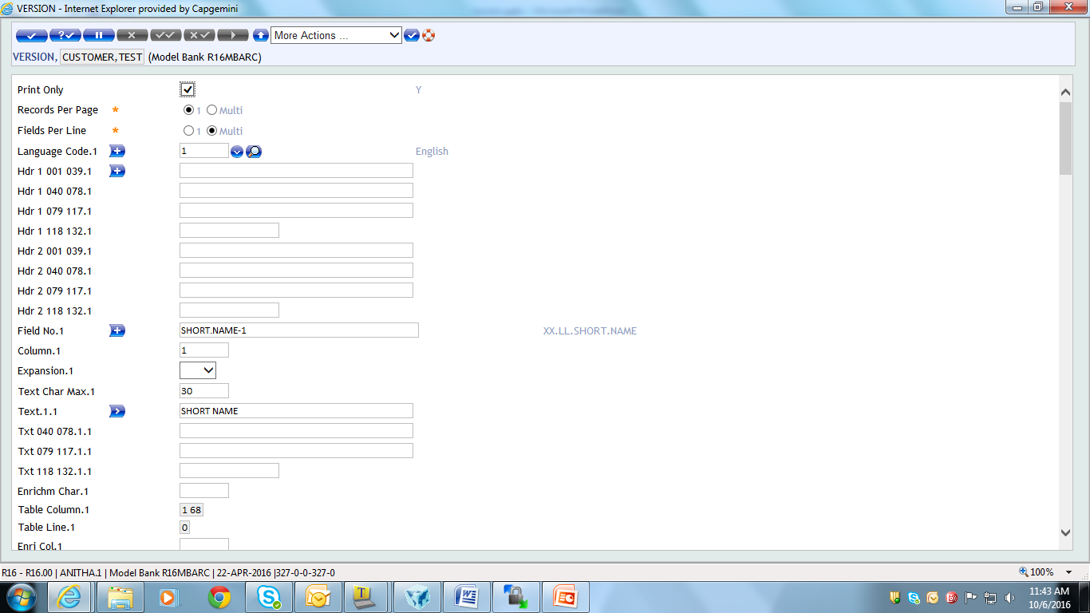
Version

Slide 14
Version – Fields
Print Only
Indicates whether version being created is to be used for printed report or online screen

Slide 15
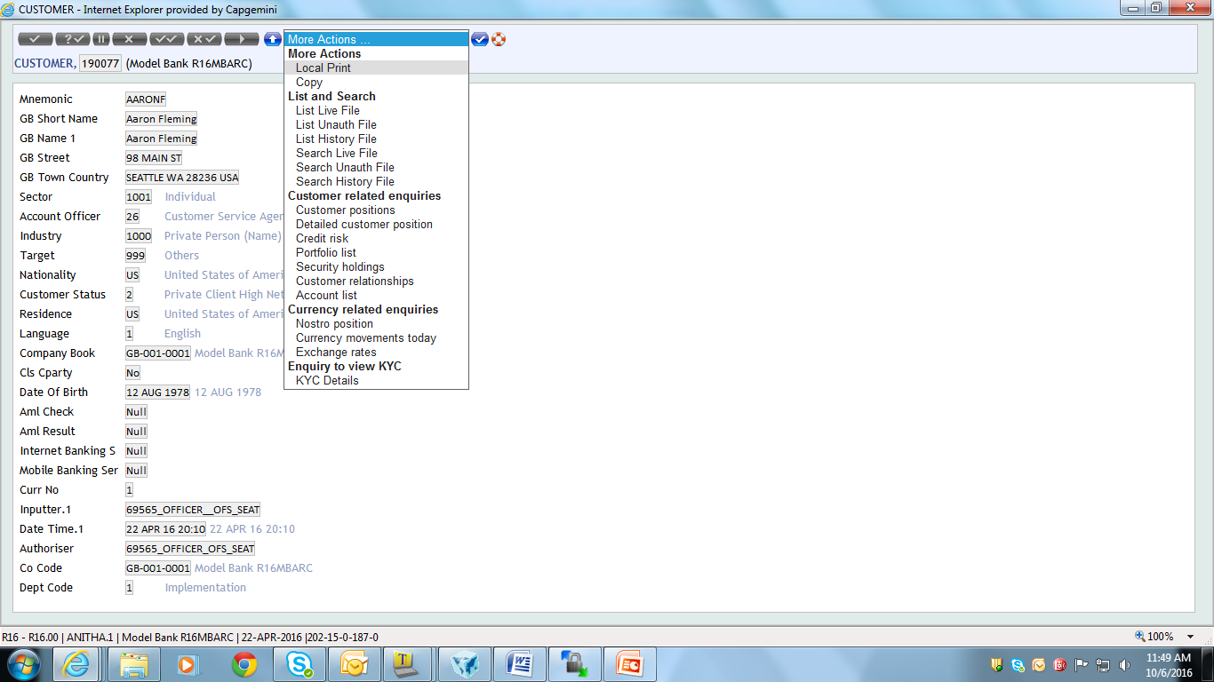
Version – Field – ‘Print Only’
To print the record, open the record in See mode
Select “Local Print” from the “More Actions” menu

Slide 16
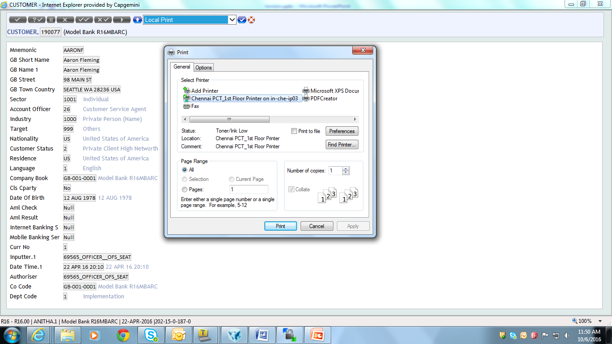
Version – Field – ‘Print Only’
Pop-up appears as shown, on selecting ‘Local Print’

Slide 17
Version – Fields
Records Per Page
Indicates number of records to be displayed per page
Possible input:
1 – Displays one record per page
MULTI – Displays multiple records per page. E.g. input of the exchange rates of various currencies on one single screen

Slide 18
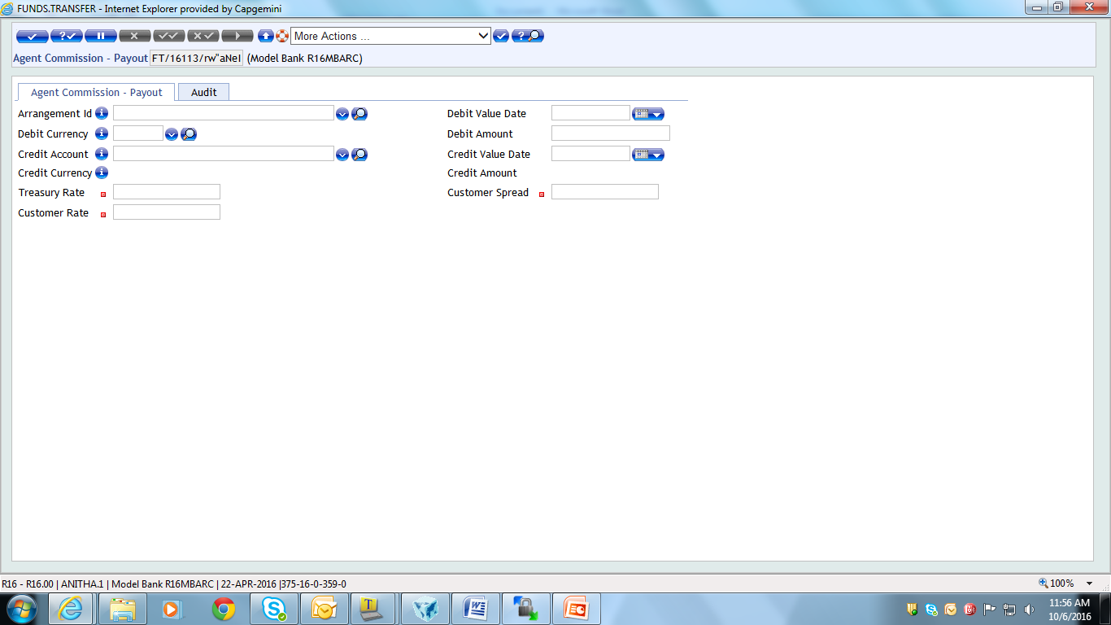
Version – Fields
Fields Per Line
Indicates no. of fields to be displayed per line
Possible input are:
1 – Display only one field per line
MULTI – Displays multiple fields per line
Screen shot shows display of multiple fields per line

Slide 19
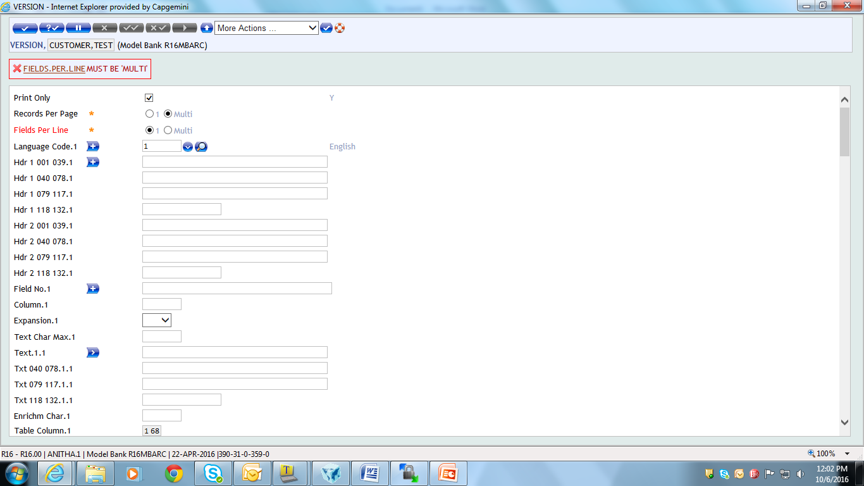
Version – Fields
If ‘Records Per Page’ is Multi, then ‘Fields Per Line’ should also be Multi.
Error is thrown

Slide 20
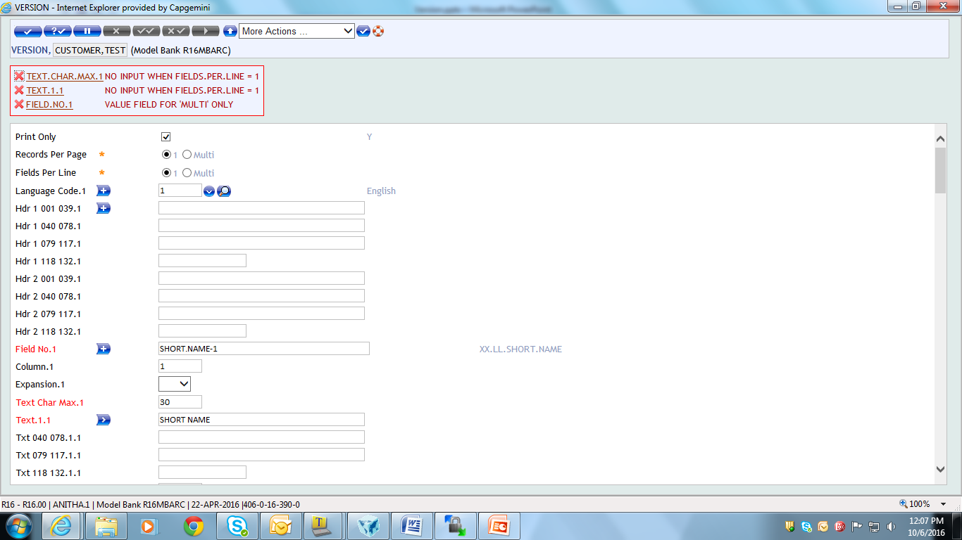
Version – Fields
When Fields Per Line = 1, then ‘Text Char Max’ & ‘Text’ becomes No Input fields

Slide 21
Version – Fields
Language Code – Indicates code of the language to be used in the Version
Hdr.
Allows display of heading for the version
Enables the first line of headings for columns 01 to 39 of the screen or printed report to be specified
This first heading line will appear on line number 2 in the header lines
Spaces will not be ignored

Slide 22
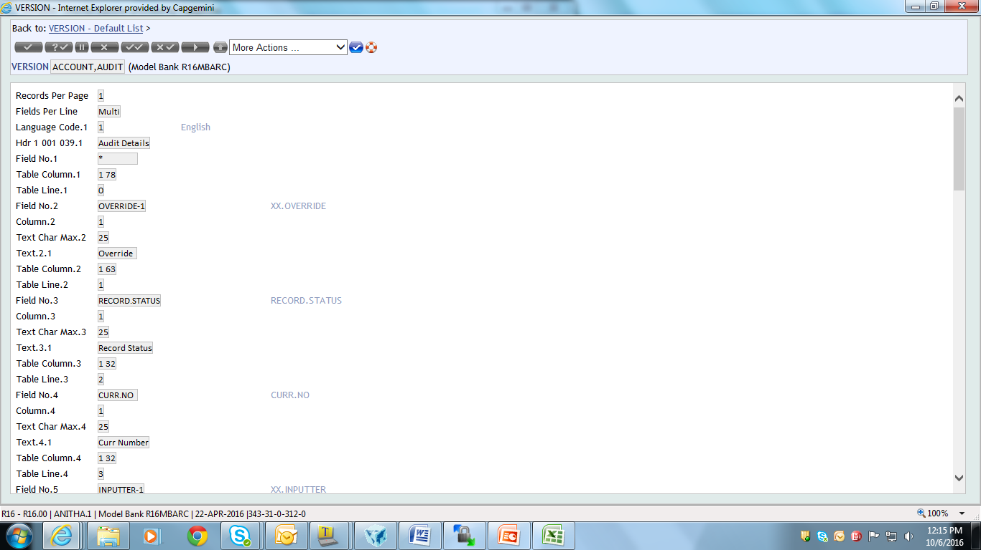
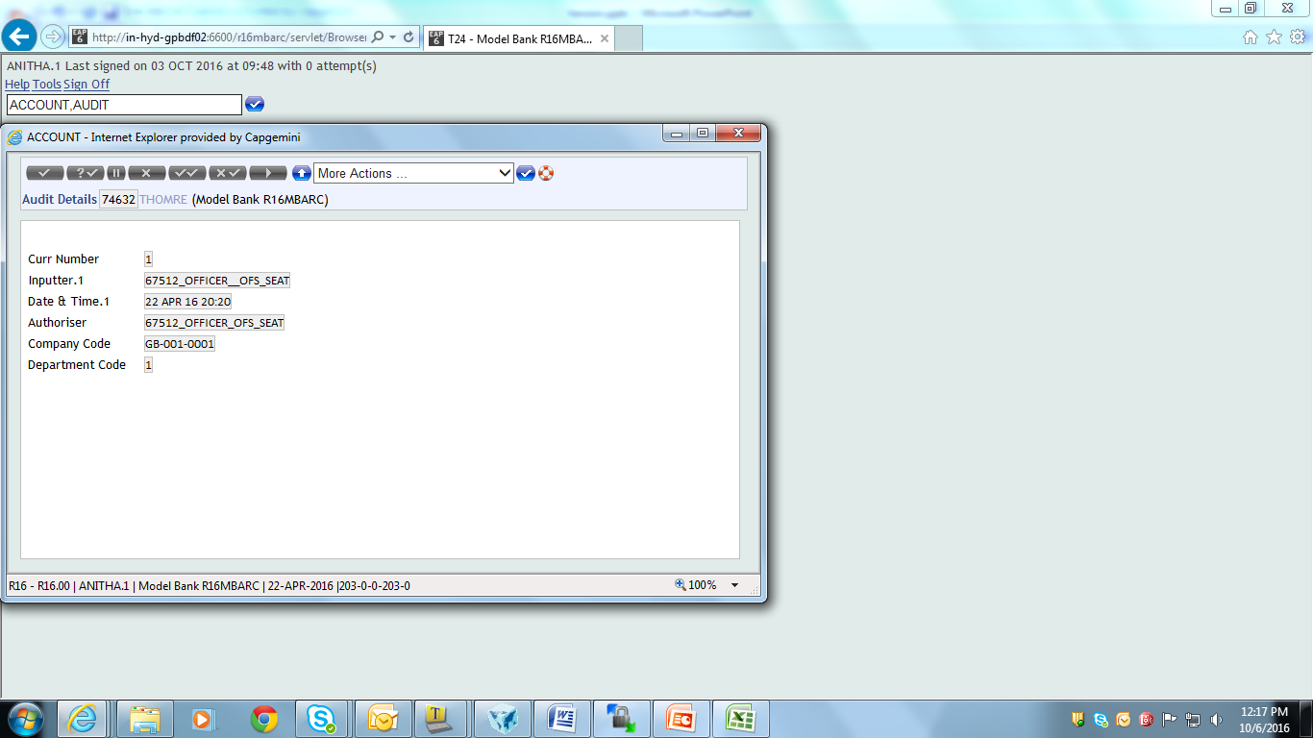
Version – Fields – Hdr.

Slide 23
Version – Fields
Field No. – Enter a valid field name
Column – Enter the column no. for display of field
Expansion
Indicate whether the field can be expanded
Applicable for multi-value and sub-value fields
Options:
Blank -> Allow expansion
NO -> Prevents expansion of multi-value field

Slide 24
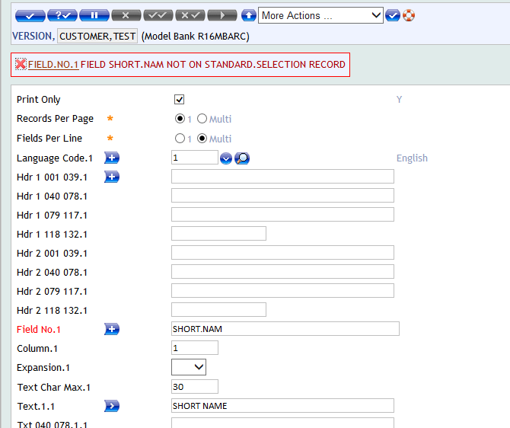
Version – Fields

Slide 25
Version – Fields
Text char max. (System updated)
Indicates the length for the Text (e.g. field name) relating to the field defined in ‘FIELD NO’ field
Determines the total number of characters (including spaces) included in the ‘Text’ field
Text
Indicates the Text that User wants to display for the field specified in ‘FIELD NO’ field
This is a sub-value field, hence allow the Text to be entered in the various languages defined in ‘Language code’ field

Slide 26
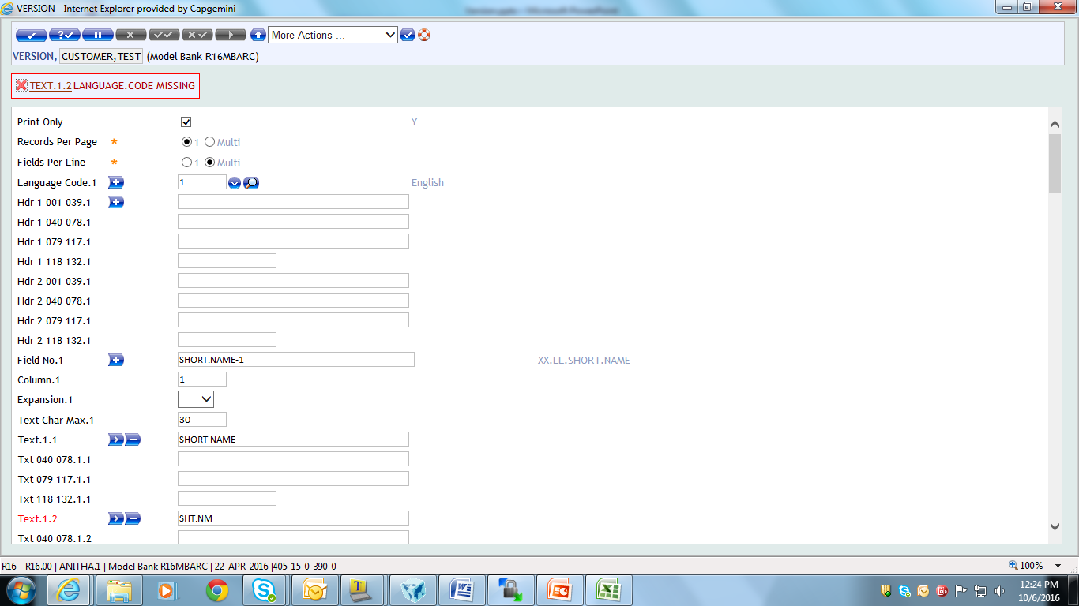
Version – Field – Text
Only one language code is selected here
But, Text field is multi valued here, so it throws error

Slide 27
Version – Fields
Txt.
Text given here is displayed as remark line, when symbol ‘*’ is set in ‘FIELD NO’ field
Spaces which are created by the User in this field will not be ignored
Enrichment char
Indicates how many characters the User wishes to reserve for the display of the enrichment of an input field

Slide 28
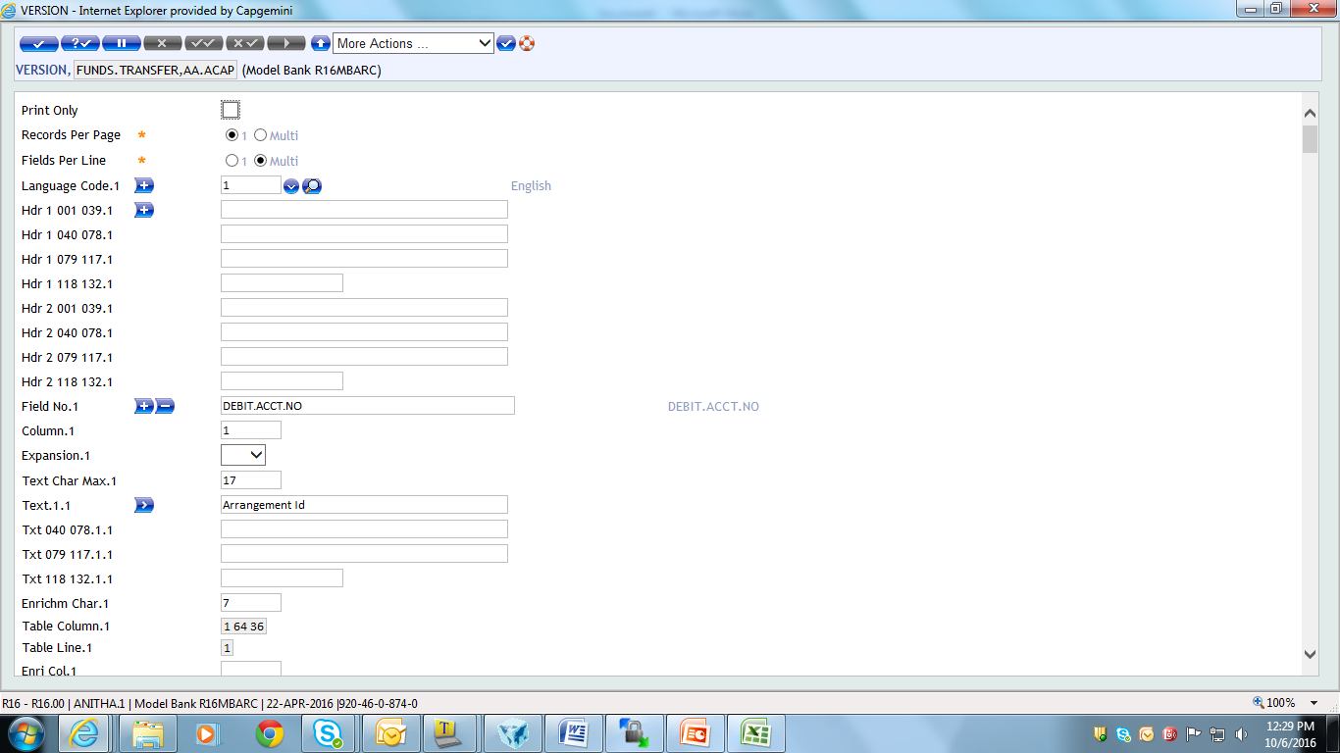
Version – Field – Enrichment char.

Slide 29
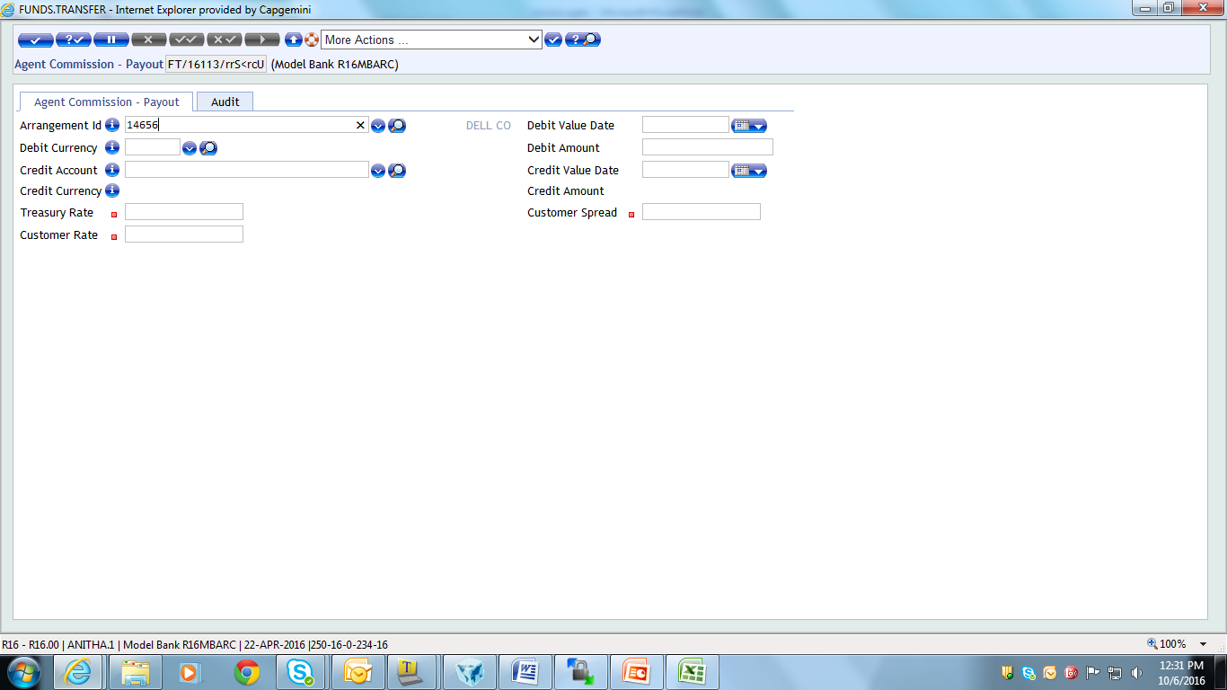
Version – Field – Enrichment char.
Show the display of Enrichment for the field ‘Arrangement Id’

Slide 30
Example1
Create a simple version for FT module containing only the mandatory fields

Slide 31
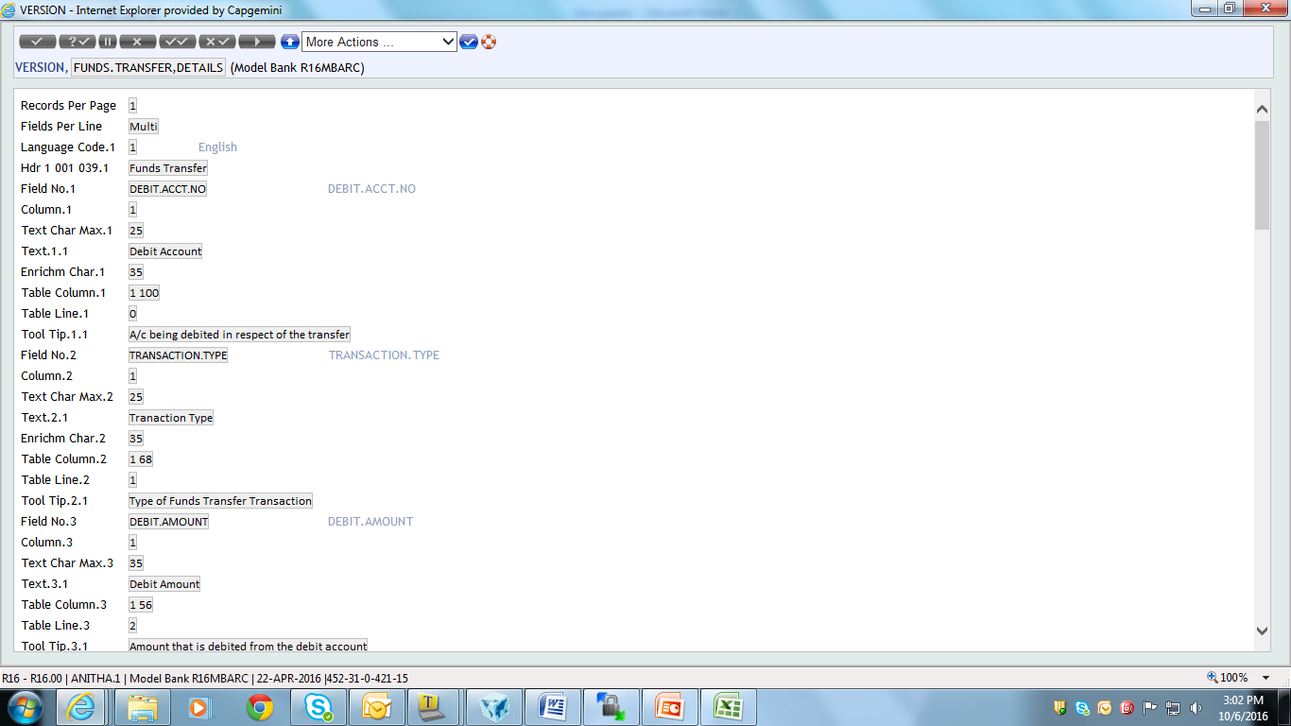
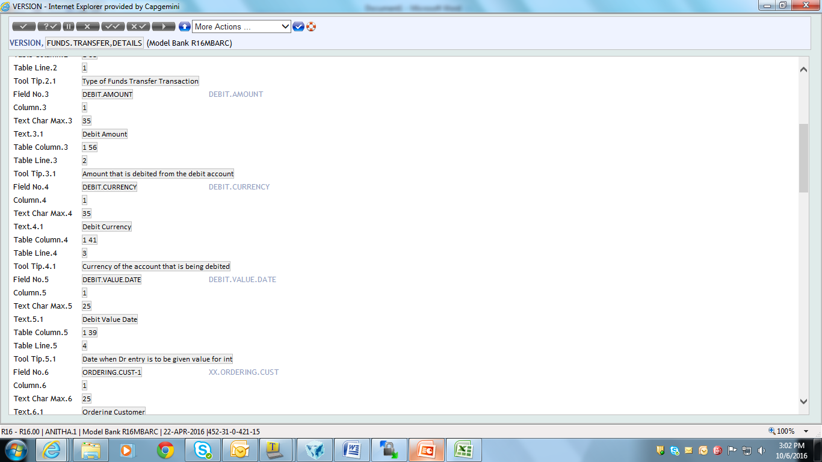
Solution 1

Slide 32
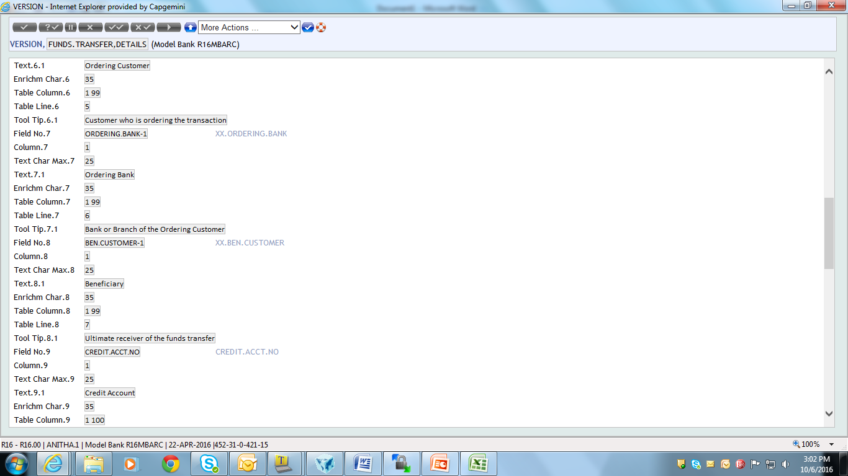
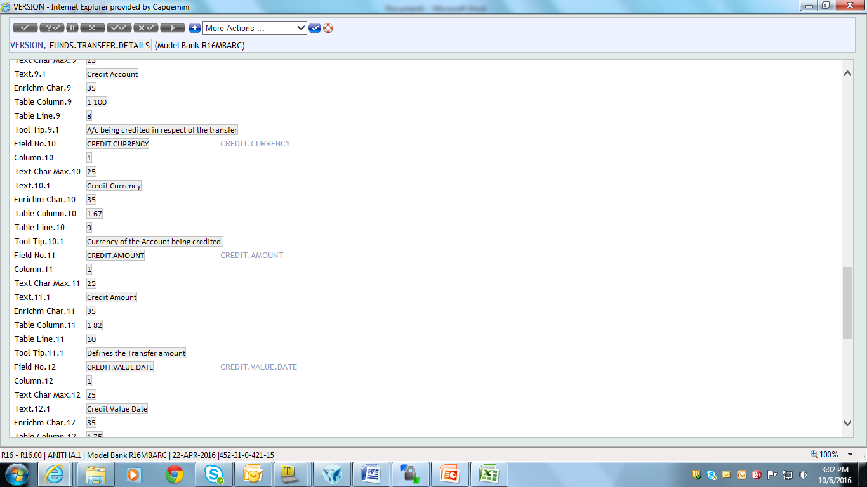
Solution 1

Slide 33
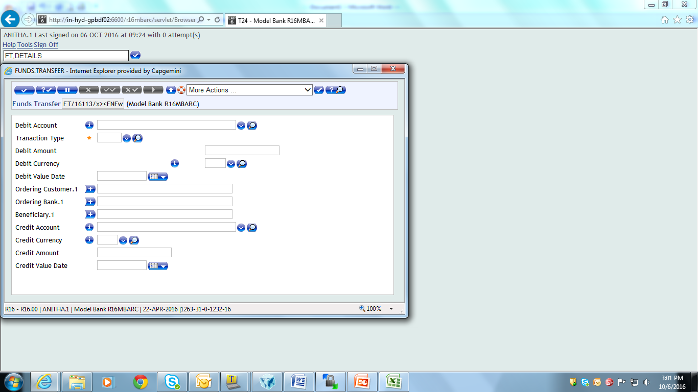
Solution 1
Output of the version

Slide 34
Version – Field
Prompt Col
Specifies the Position of the Prompt for the field
When value for this field is set, then the existing value of the field COLUMN denotes the position of the Editable / Display value
Tool Tip
Text entered here is displayed near the mouse pointer, when it is at rest pointing to the associated field

Slide 35
Version – Field
Drop Down
ENQUIRY to be used to generate the drop down list for the field
Associated with this field is the field ‘ENQ.SELECTION’ which is used to define the selection fields on the enquiry
Expansion
Indicates whether the Field Number previously defined can be expanded when using this Version in an on-line session
Used when ‘Field per Line’ field is equal to MULTI
Used when the User does not want to allow expansion for multivalue and sub-value fields

Slide 36
Example 2
Create a version to
Display ‘Category’ field name in column 30
Add tooltip to ‘Mnemonic’ field
Display list of account as drop-down for ‘Charge account’ field
Disable expansion of Premium type field

Slide 37
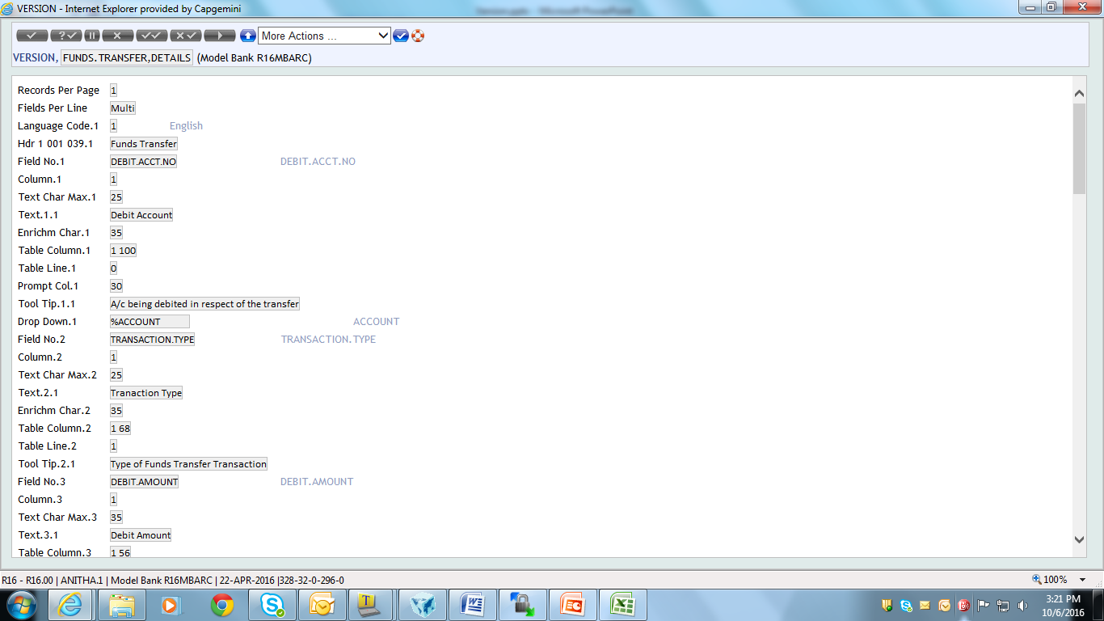
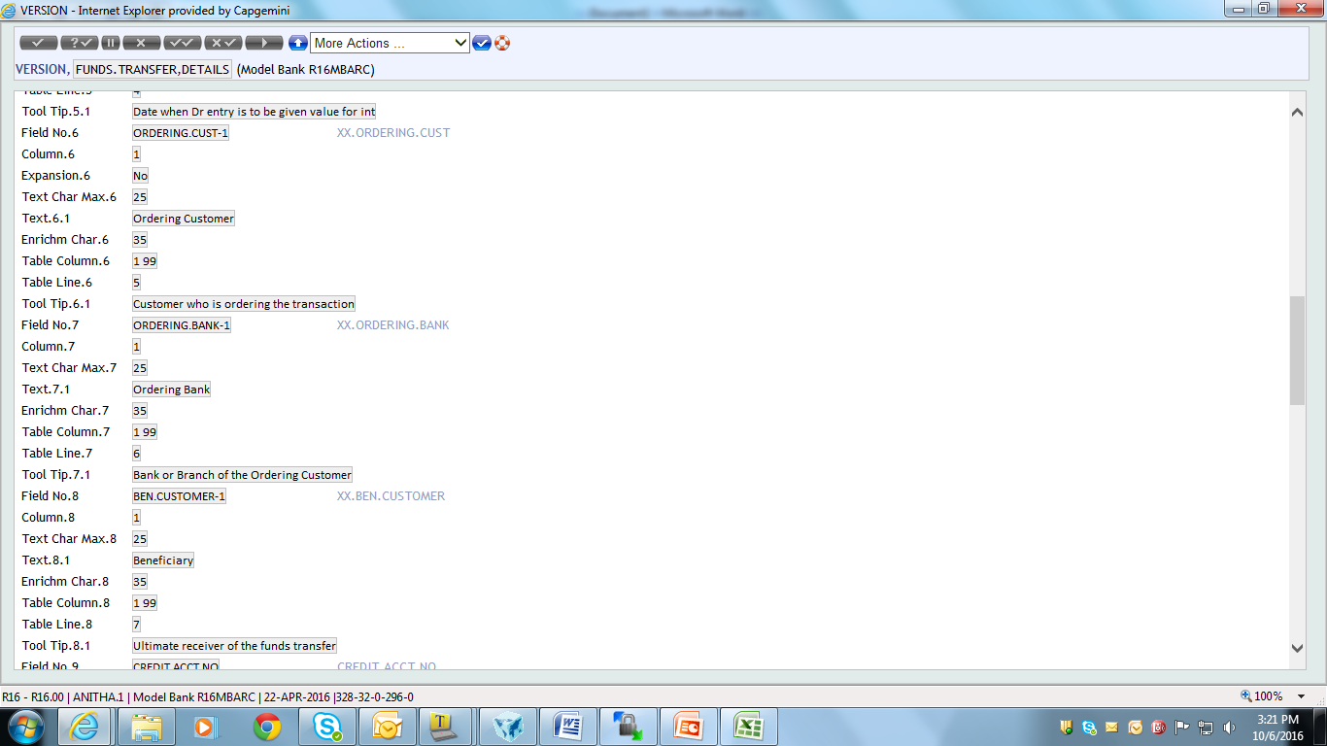
Example 2

Slide 38
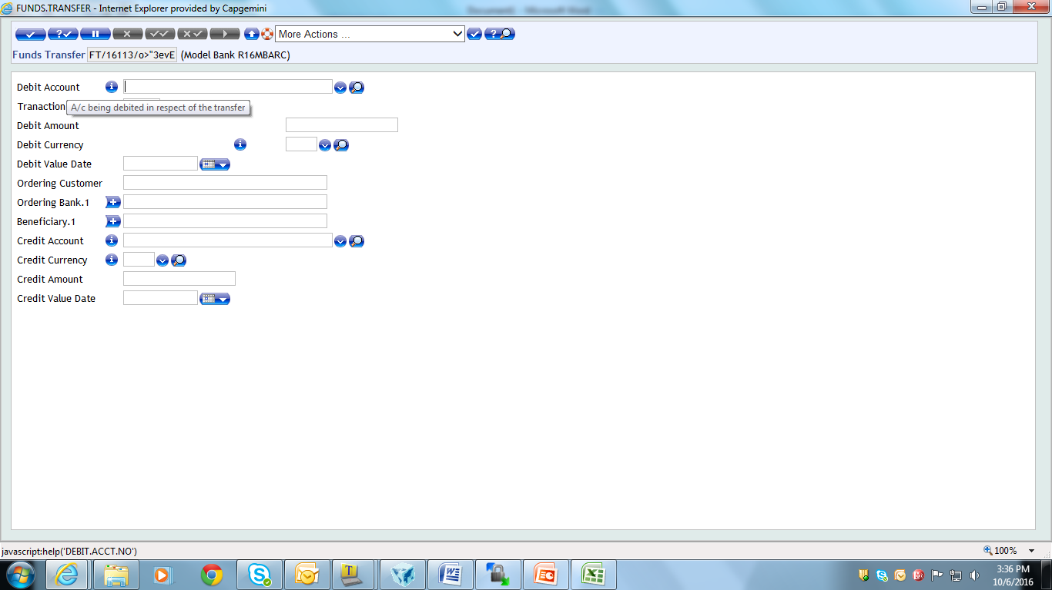
Solution 2
Output of the version appears as shown
Tooltip for ‘Debit Account’ field
Expansion for ‘Ordering Customer’ field is disabled

Slide 39
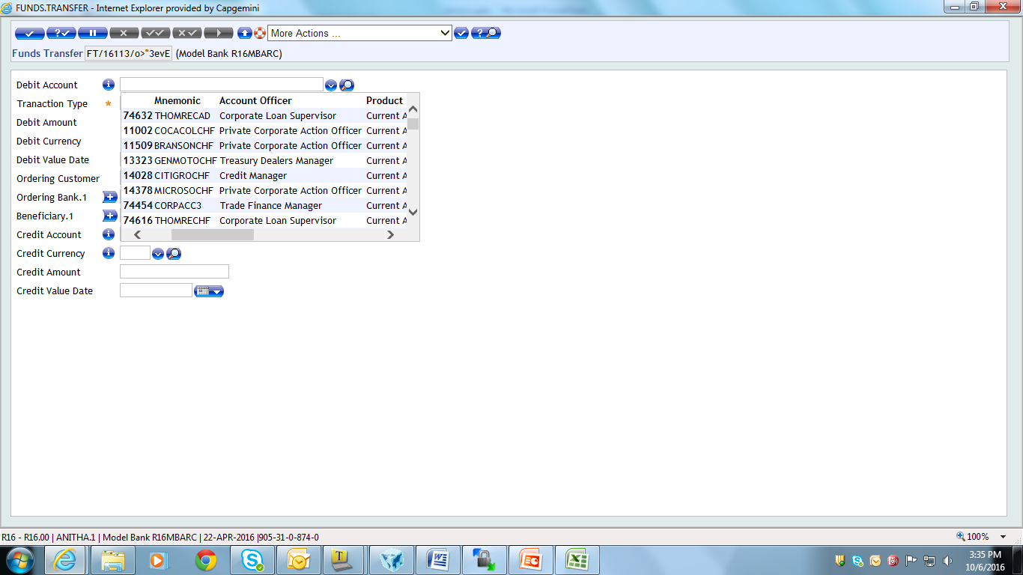
Solution 2
‘% Account’ enquiry is displayed as dropdown list for the ‘Debit Account’ field

Slide 40
Version – Field
Case Conv
Define the case conversion for the field data.
Blank (default) -> No case conversion is done
Lowercase -> All text is converted to lower case
Uppercase -> All text is converted to upper case
Proper case -> Text is converted to proper case, i.e. each word begins with a capital letter, other text is lower case

Slide 41
Version – Field
Hyperlink
Enter the name of an application, VERSION or script
Invoked when the user clicks on the associated text

Slide 42
Example 3
Create a version to convert text input in ‘Mnemonic’ field into text with 1st letter in capital

Slide 43
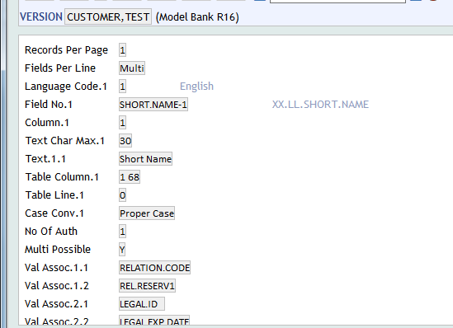
Solution 3

Slide 44
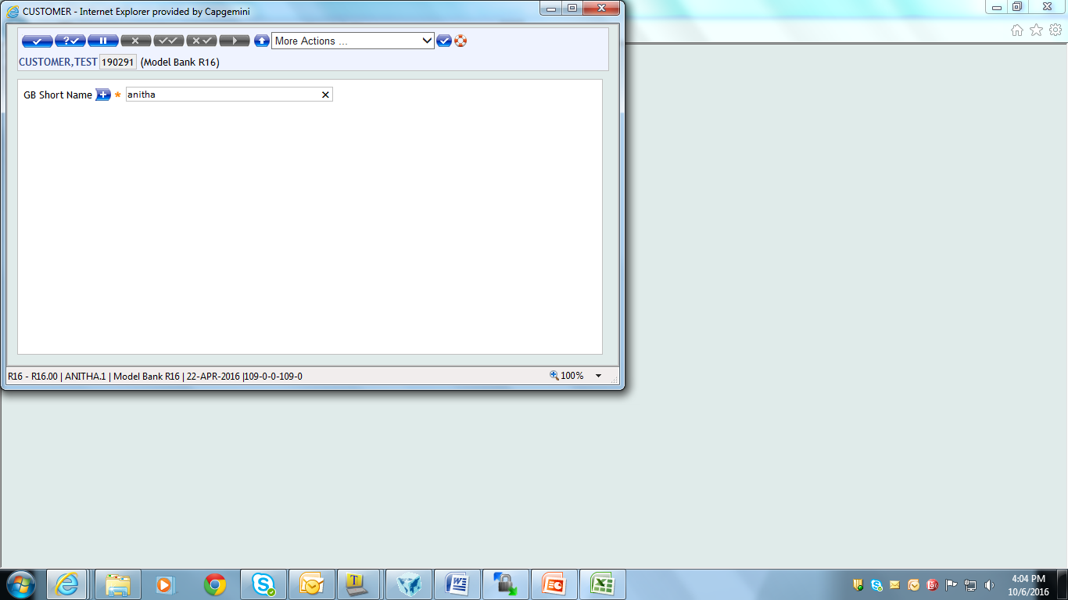
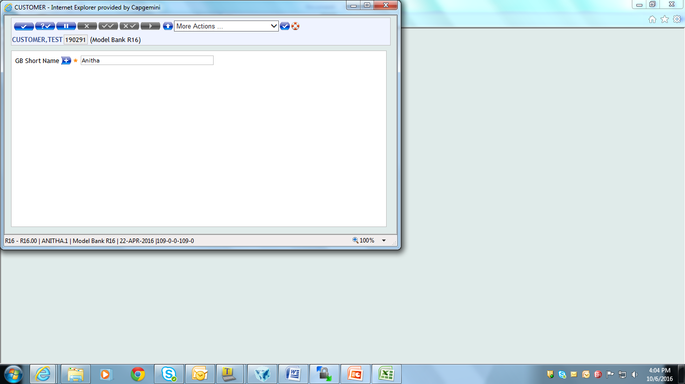
Solution 3
Output of the version appears as shown
Input the text and press tab, the text will be converted to Proper Case as shown below

Slide 45
Version – Field
Idesc
I-Descriptors (IDESC) are used to define field name using which fields from another T24 application can be accessed
It is defined in the STANDARD.SELECTION record of the FILE, as a Type I or J item, followed by the FIELD.NAME XXX
I-descriptor of I Type enables access between different T24 applications using subroutine
I-descriptor of J Type enables access between different T24 application using symbol ‘>’

Slide 46
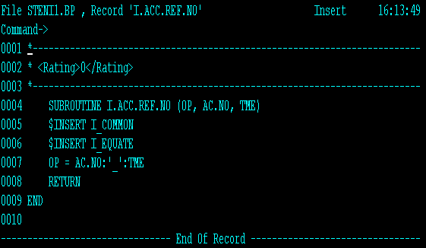
Idesc creation
Write a subroutine to extract the account number and currency
Notes:
This subroutine will get two values – ACCOUNT.NUMBER in AC.NO and CURRENCY in TME from the ACCOUNT Application.
Then it will return one value – OP which contains the two values separated by “_”

Slide 47
Example 4
Create an enquiry for account application displaying
Account no. followed by ‘_’ and the corresponding currency
Industry of the corresponding customer (using I-descriptors)

Slide 48
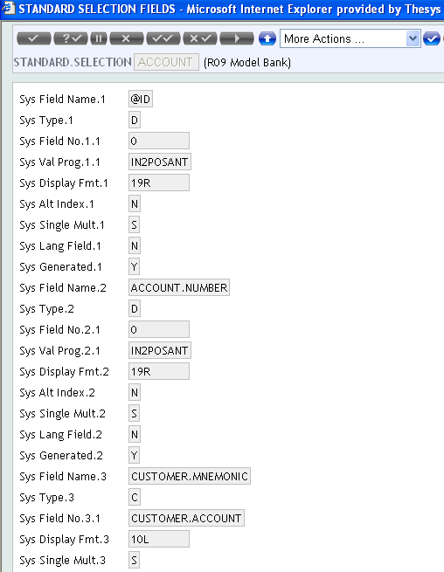
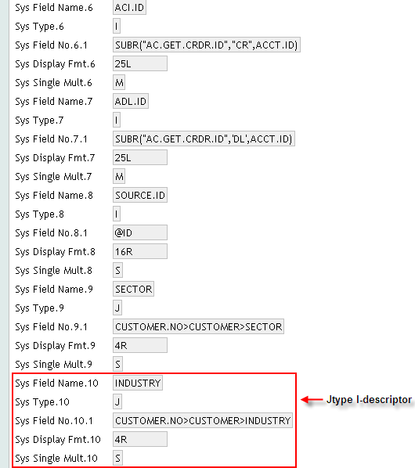
Solution 4
Make an entry of the I-descriptors in Standard Selection file

Slide 49
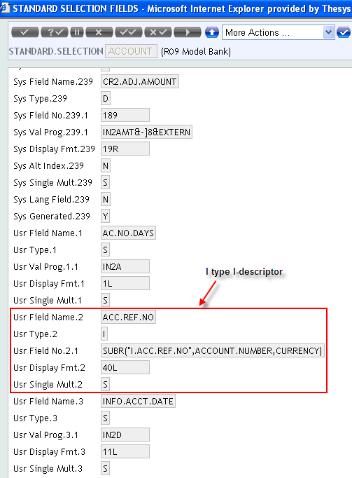
Solution 4 (cont..)

Slide 50
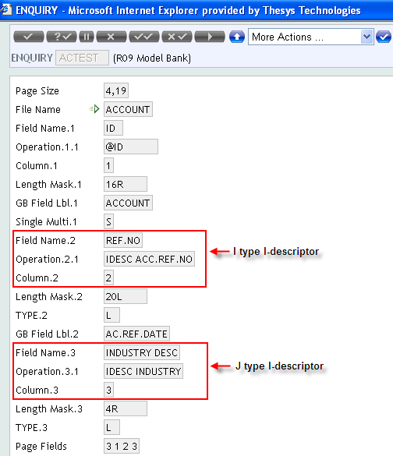
Solution 4

Slide 51
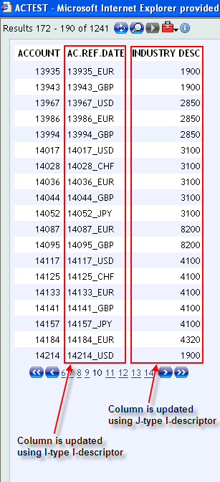
Solution 4
Output of the enquiry appears as shown

Slide 52
Version – Field
Attribs
Define number of Attributes for the Version
Includes defining whether the field is a Hot Field or not
Used to default other field values once the current field value has been entered

Slide 53
Version – Field
Display Type
NO DISPLAY -> no change on the version field.
TOGGLE
Changes the field in a button labelled with the field name
Can display two states only by appearing in white or grey
CHECKBOX -> Display two states denoted by an empty square box or a box with a tick in it

Slide 54
Version – Field
Popup Control
Allows a popup control such as calendar, calculator or rate control to be associated with the corresponding field

Slide 55
Example 5
Create a version populating calendar near the ‘Opening date’ field

Slide 56
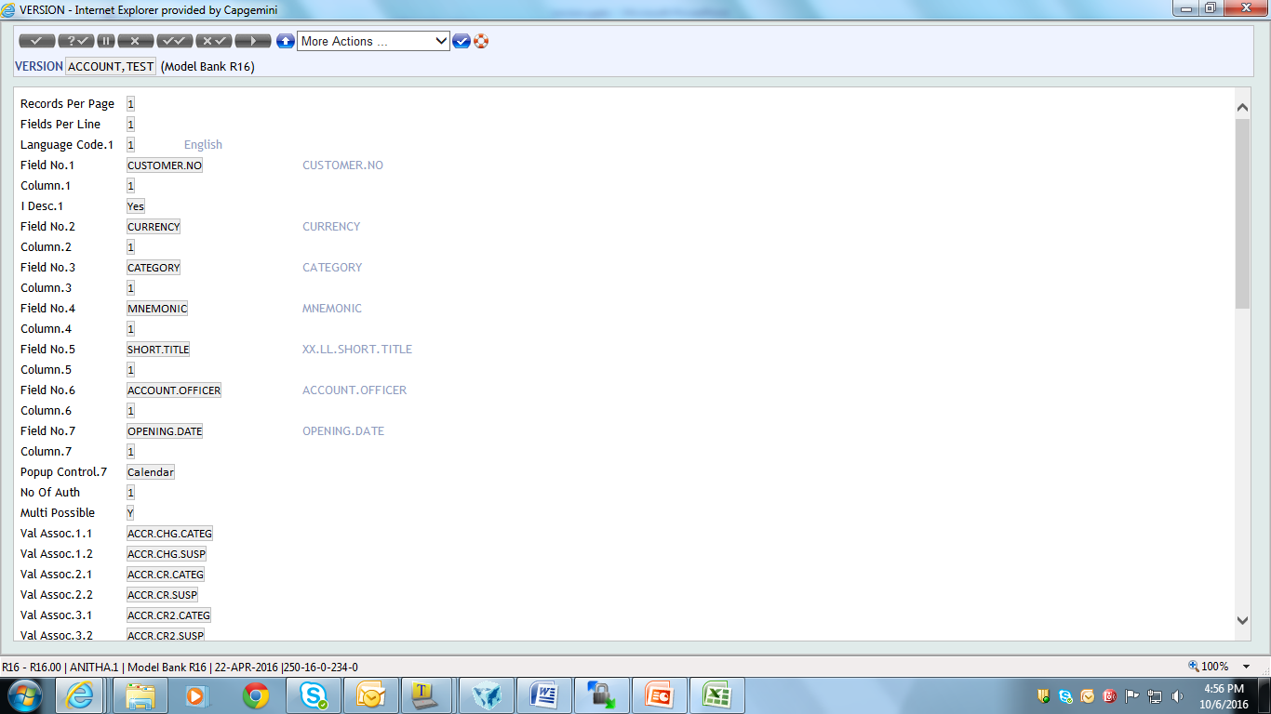
Solution 5

Slide 57
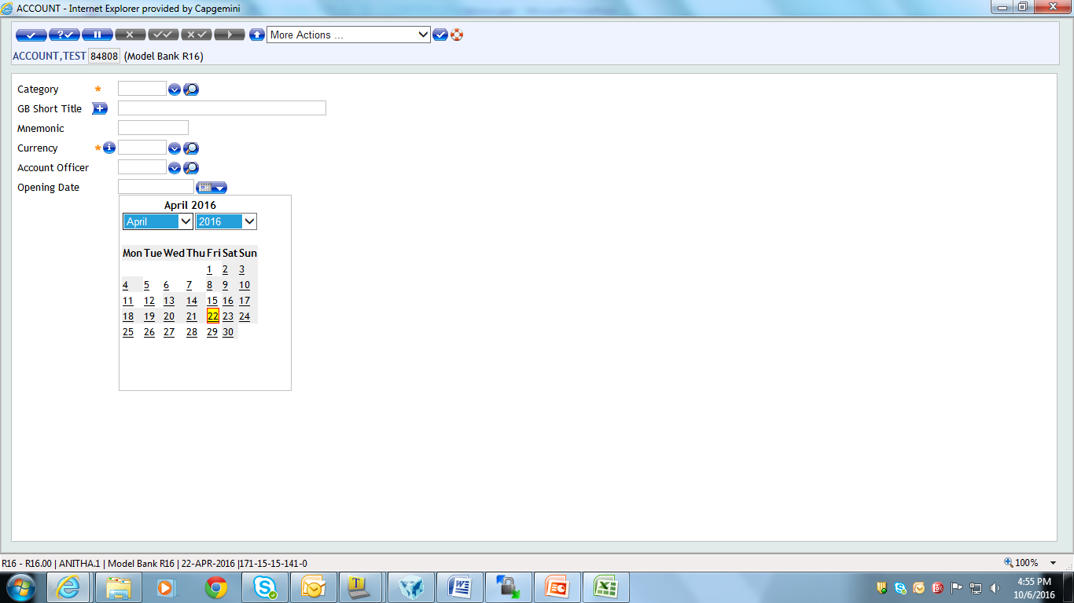
Solution 5
Output of the version appears as shown

Slide 58
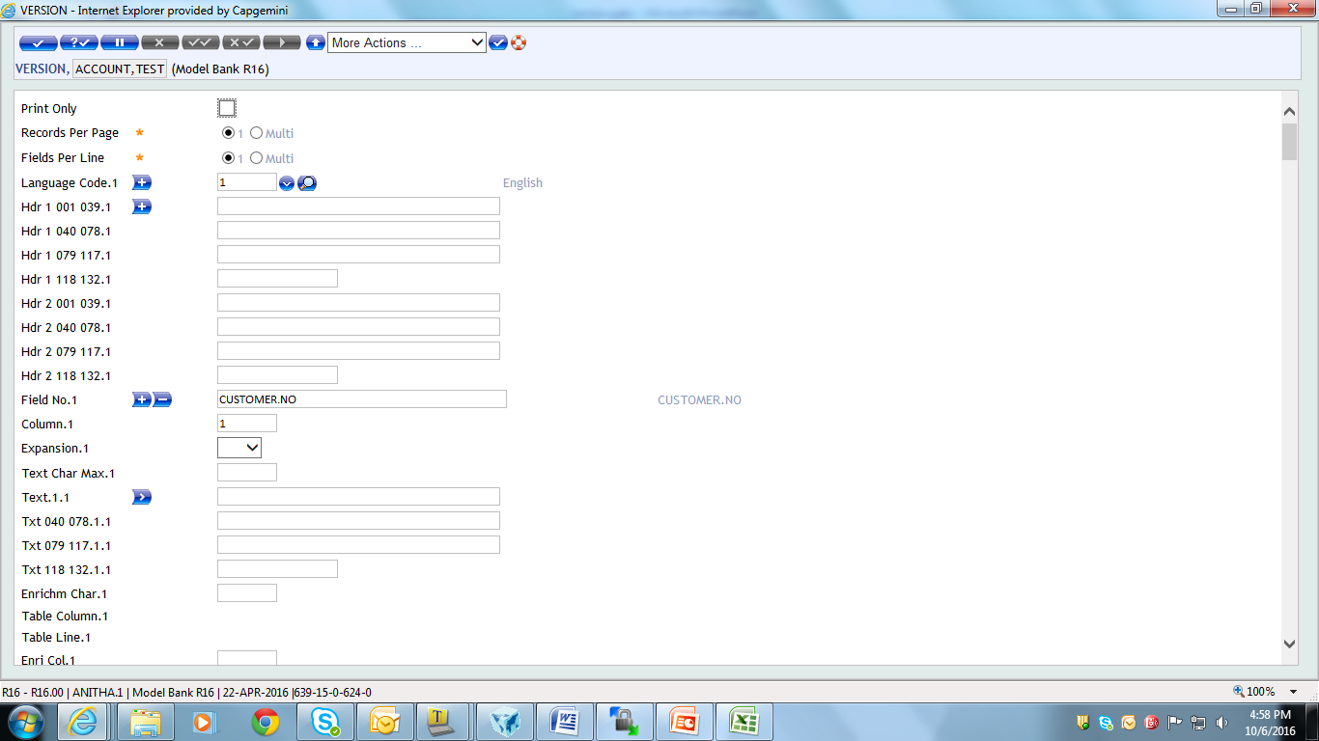
Adding Header to Version
Use field ‘Hdr’ in Version application to add heading to the version

Slide 59
Example 6
Add a suitable heading “Funds Transfer Related Information” to the version created in Example1

Slide 60
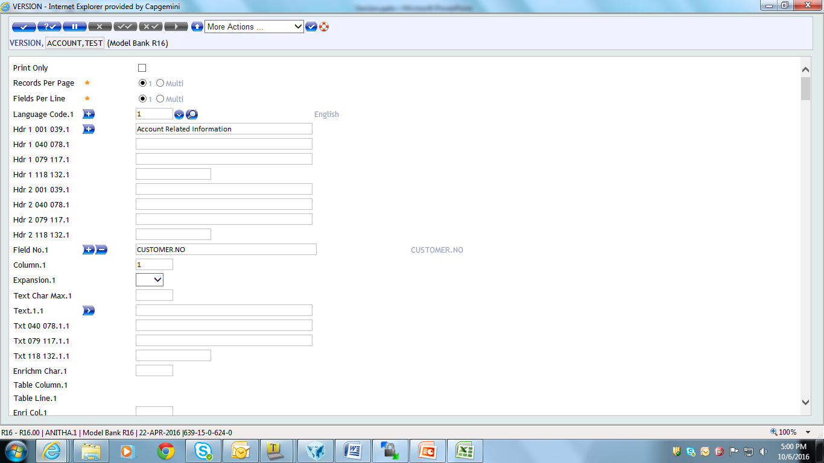
Solution 6
Enter required heading in ‘Hdr’ field

Slide 61
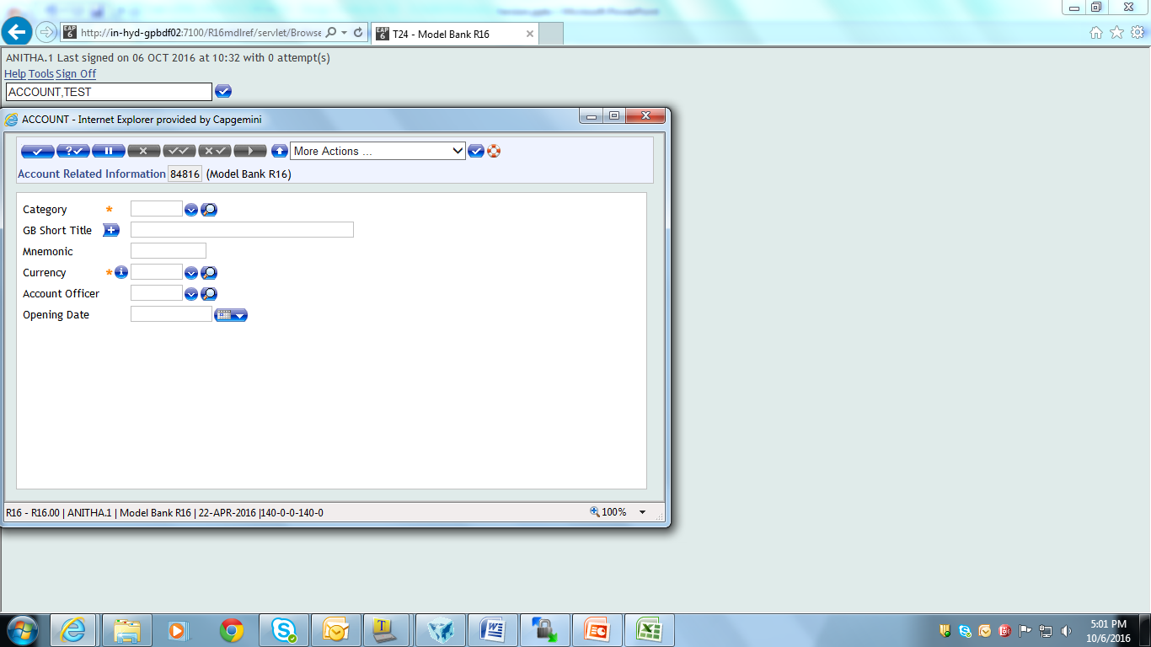
Solution 6
Screen shot of newly created version

Slide 62
Displaying multiple fields per line
Use field ‘Fields Per Line’ in version application
1 – To display single field per line
MULTI – To display multiple fields per line

Slide 63
Example 7
Create a version for FT application displaying only mandatory fields, using multiple fields per line

Slide 64
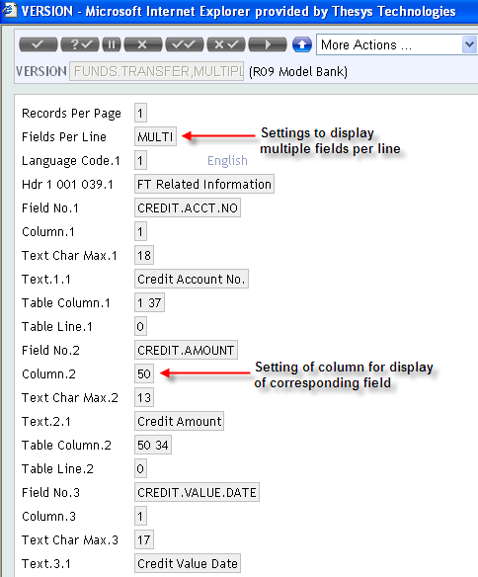
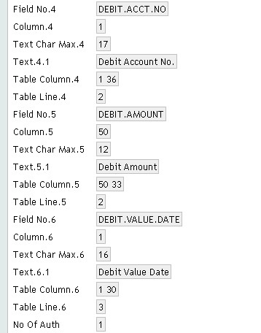
Solution 7
Select ‘MULTI’ from ‘Fields Per Line’ field

Slide 65
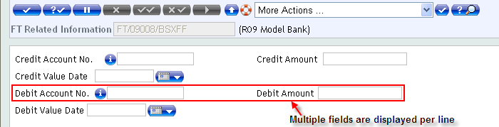
Solution 7
Value entered in ‘Text’ field is displayed for each field in the Version
E.g. Credit Account No. is displayed from value entered in ‘Text’ field, during the creation of version

Slide 66
Adding sub-headings to version
Sub-headings can be added to version application using the following fields
Field name – Enter ‘*’, where * means sub-heading/comment line
Column – Indicates Column on which the sub-heading should be displayed
Text – Enter suitable sub-heading

Slide 67
Example 8
Add sub-headings “Credit Related Information” and “Debit Related Information” above corresponding fields, to version created in Example 3

Slide 68
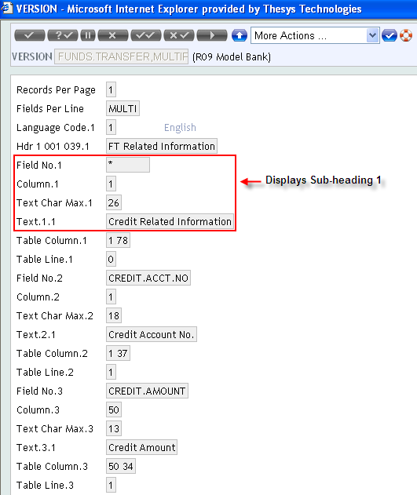
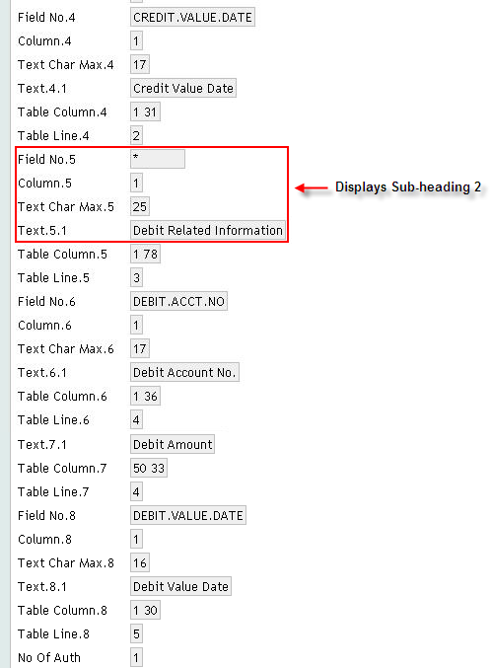
Solution 8

Slide 69
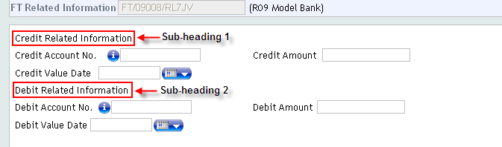
Solution 8

Slide 70
Workshop 1
Create a version for account module containing the following fields:
Category
Currency
Mnemonic

Slide 71
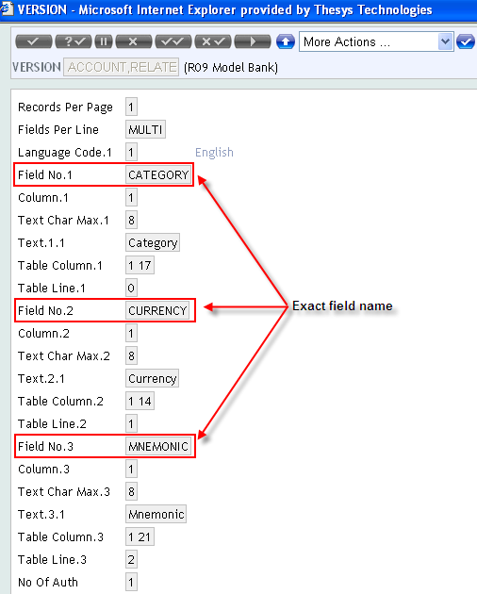
Solution 1
Add required field names in ‘FIELD NO’ field

Slide 72
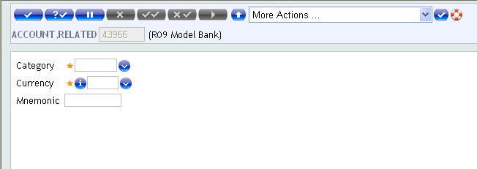
Solution 1
Version of the application appears as shown

Slide 73
Workshop 2
Create a version for customer module
Containing the following fields: Mnemonic, Short Name, Name.1, Relation code, Related customer, Sector, Account officer, Industry, Target, Nationality and Language
Mnemonic, Short Name, Name.1 should fall under sub-heading “Customer Information”
Relation code, Related customer should fall under sub-heading “Reference Information”
Other fields should fall under sub-heading “Other Information”

Slide 74
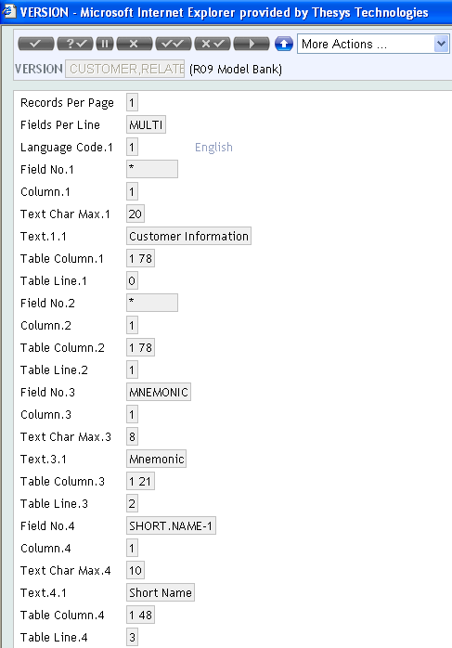
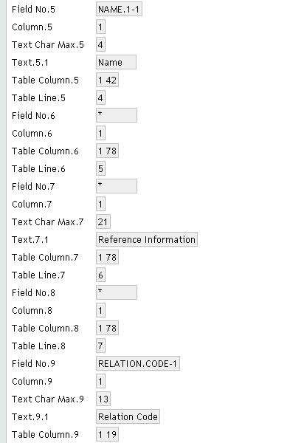
Solution 2

Slide 75
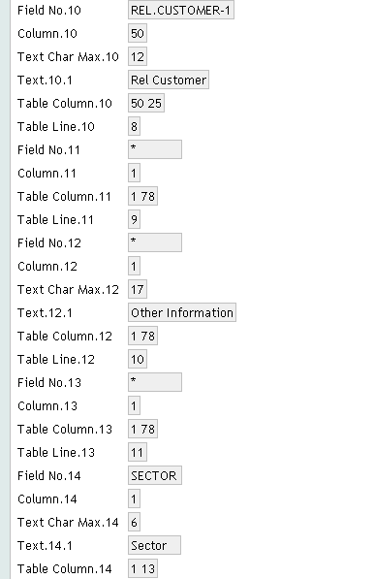
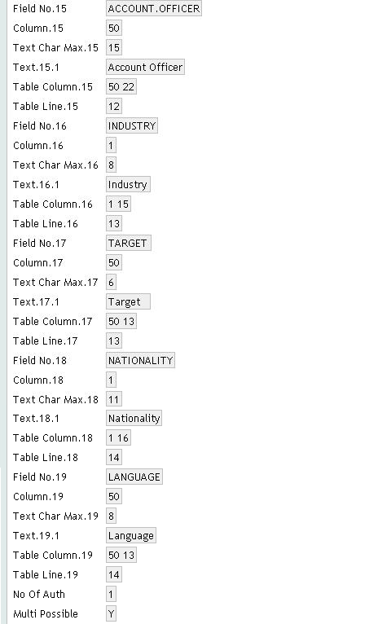
Solution 2

Slide 76

Solution 2
Shows display of newly created version

Slide 77
Version – Current Variables
Version can be called from enquiries and values can be defaulted from enquiries to version using current variables.

Slide 78
Example – Current Variable
Create Enquiry for Account application with fields Customer and Account Title. Create a version for Customer and populate Family Name field in version with Account Title.1.

Slide 79

Example – Current Variable
Create Enquiry for Account application
Name of the version to be called in Enquiry Field of Enquiry Application

Slide 80

Example – Current Variables
Create Version for Customer Application

Slide 81

Example – Current Variables

Slide 82


Example – Current Variables

Slide 83


www.capgemini.com/financialservices

